Slide 1
Application Layer Protocols

Slide 2
What is?
The application layer is present at the top of the OSI model.
It is the layer through which users interact. It provides services to the user.
Application layer performs several kinds of functions which are requirement in any kind of application or communication process.

Slide 3
Telnet
TELNET stands for Teletype Network.
It is a type of protocol that enables one computer to connect to the remote computer.
The computer which starts the connection is known as the local computer.

Slide 4
Telnet
The computer which accepts the connection known as the remote computer.
Telnet operates on a client/server principle.
The local computer uses a telnet client program and the remote computers use a telnet server program.

Slide 5
Telnet Logging
The logging process can be further categorized into two parts:
Local Login
Remote Login

Slide 6
Local Login
In local login, a user logs into a local system and directly connected to the target computer.

Slide 7
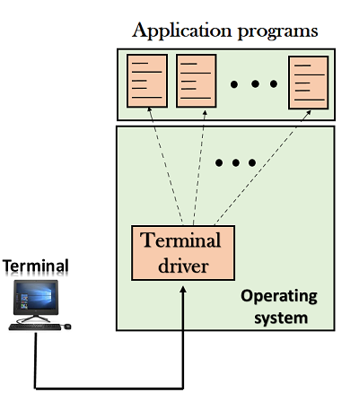

Slide 8
Local Login
The terminal driver accepts keystrokes entered by the user when the workstation is running the terminal emulator.

Slide 9
Local Login
The terminal driver subsequently forwards these characters to the operating system, which launches the required application software.

Slide 10
Remote Login
In a remote login, a user logs into a remote machine when the user wants to access an application program or utility located on a remote machine and connected to target computer through internet.

Slide 11
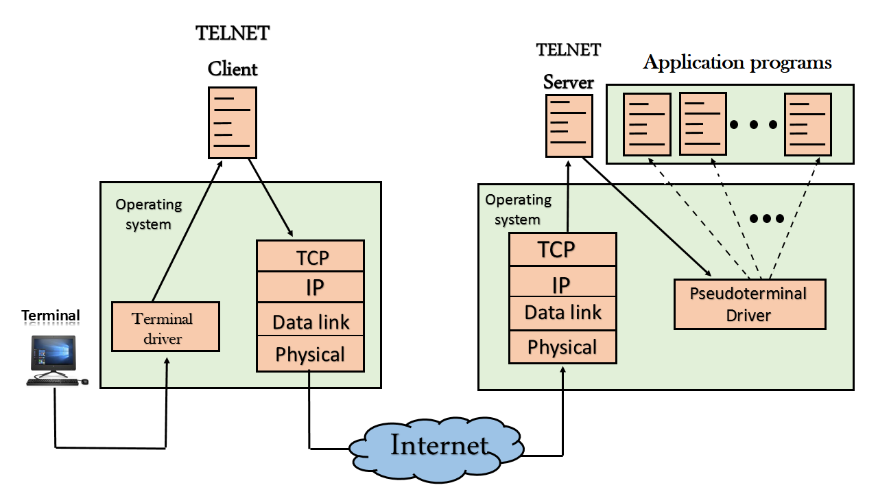

Slide 12
Procedure of Remote Login
When the user types something on local computer, then local operating system accepts character.
Local computer does not interpret the characters, it will send them to TELNET client.

Slide 13
Procedure of Remote Login
TELNET client transforms these characters to a universal character set called Network Virtual Terminal (NVT) characters and it will pass them to the local TCP/IP protocol Stack.

Slide 14
Procedure of Remote Login
Commands or text which is in the form of NVT, travel through Internet and it will arrive at the TCP/IP stack at remote computer.
Characters are then delivered to operating system and which later on passed to TELNET server.

Slide 15
Procedure of Remote Login
Then TELNET server changes that characters to characters which can be understandable by remote computer.
Remote operating system receives character from a pseudo-terminal driver.

Slide 16
Procedure of Remote Login
A pseudo-terminal driver, which is a piece of software that pretends that characters are coming from a terminal.
Operating system then passes character to the appropriate application program.

Slide 17
Advantages | Disadvantages
1. It is versatile. | 1. The data exchange is unencrypted, which makes sharing of delicate information like passwords and user IDs unsafe.
2. It provides unlimited access to target resources. | 2. Full access makes it easier for hackers to enter.
3. It can be used cross-platform. | 3. Using TELNET, only a few servers can be reached.

